Slide 1
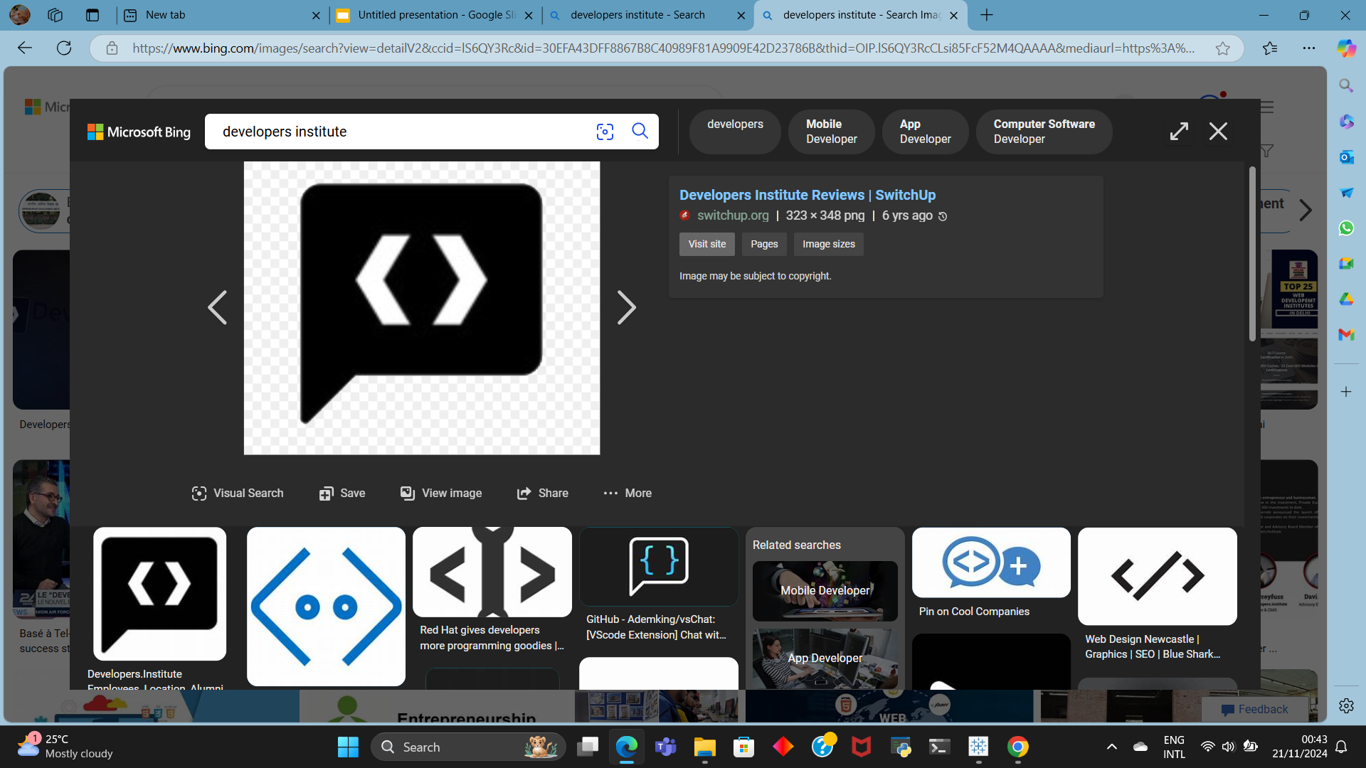
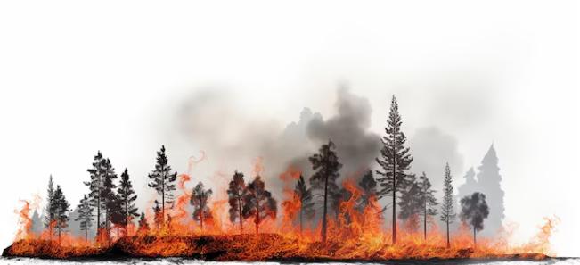
WILDFIRE
Name: Fokeerbux S B Tazmeen
[ Data Analyst]
Topic: WildFire Risk And Prediction System
Date: 23/11/24

Slide 2
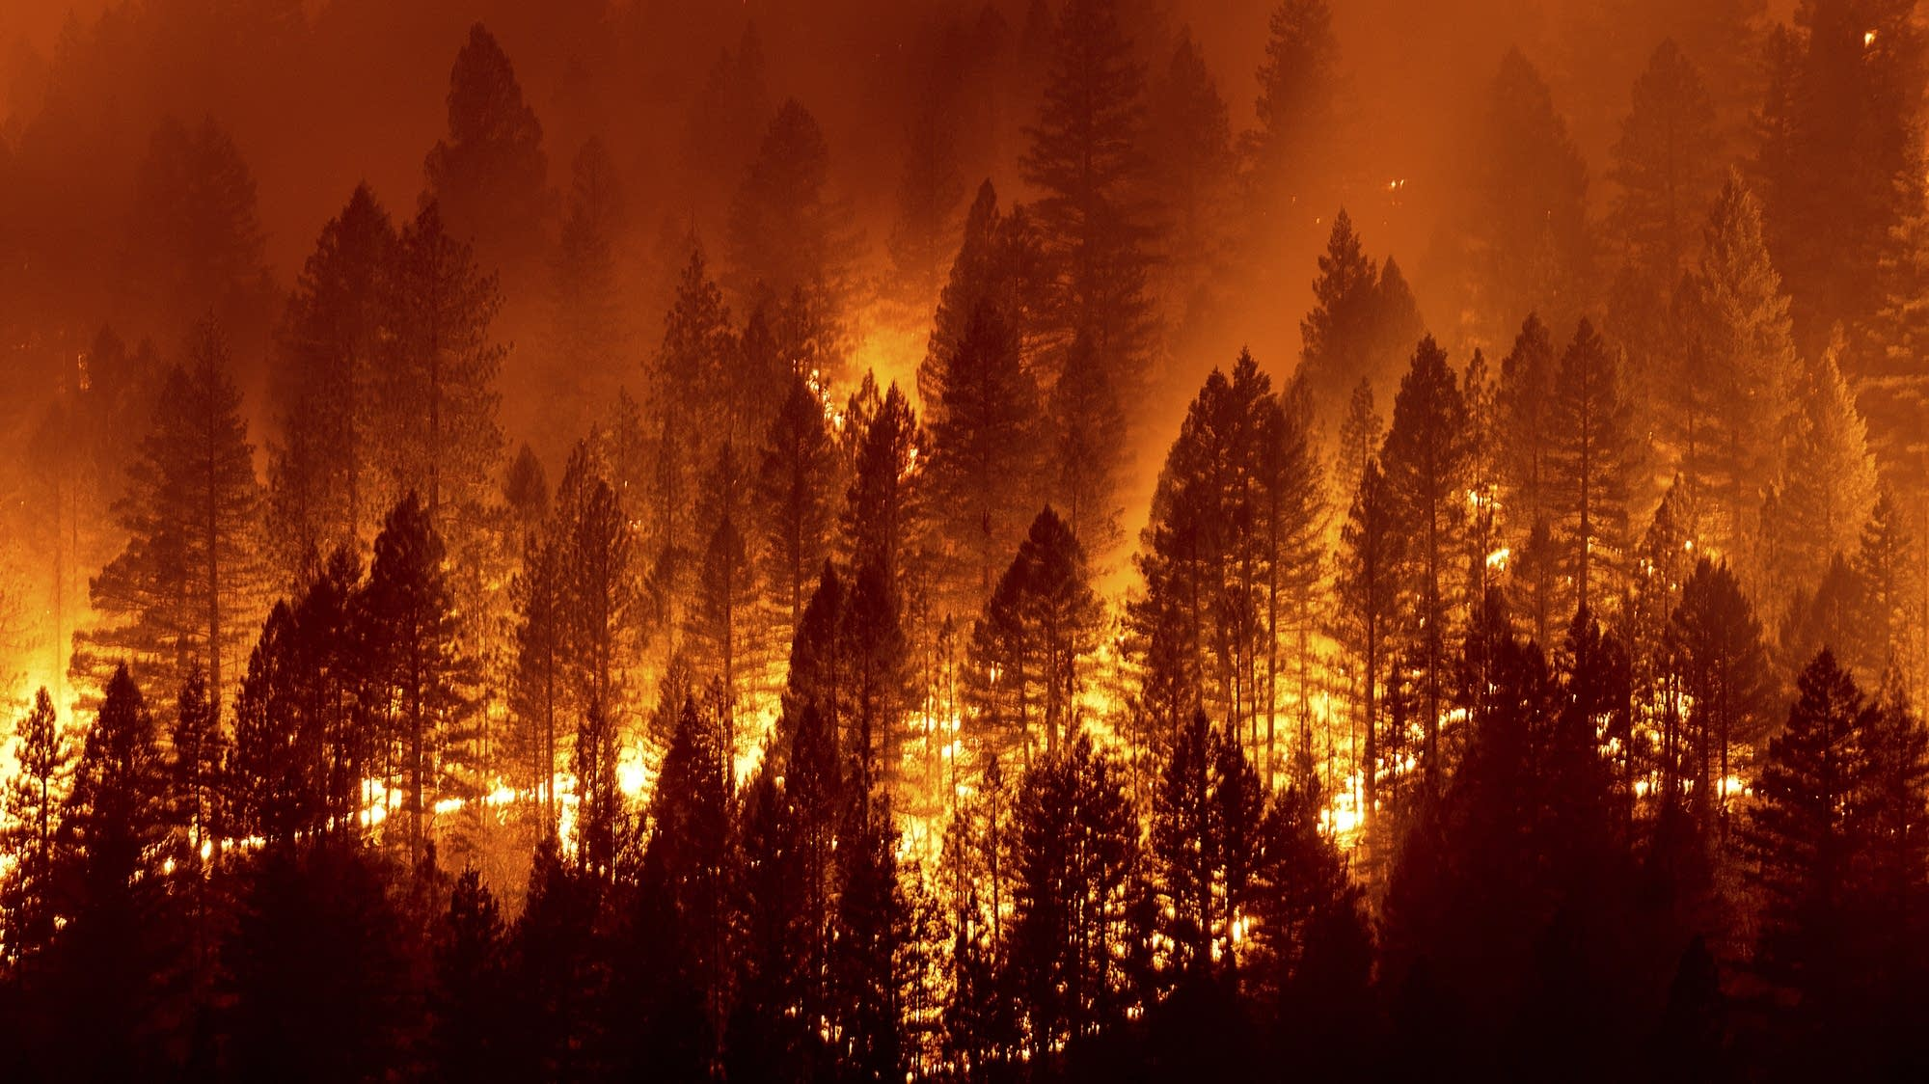
WHAT IS A WILDFIRE?
A wildfire is a large, uncontrolled fire that spreads quickly through forests, grass, or other natural areas, often caused by dry conditions, lightning, or human activities.
Each year, wildfires affect hundreds of counties, especially in places like California, Oregon, and Texas in the U.S. The number varies, but many areas, particularly in dry and hot regions, can experience fires, destruction, and evacuations.In the U.S., around 50,000 wildfires occur annually, affecting about 100–150 counties each year. California alone experiences wildfires in 30–40 counties annually. On average, 4–5 million acres of land are burned each year in the U.S.

Slide 3
Causes of WildFire
1
HUMAN CAUSES
2
Natural causes
Arson (intentional fires)
Unattended campfires
Dropped cigarettes
Faulty power lines
Agricultural burning
Lightning
Volcanic eruptions
Drought and dry conditions

Slide 4
Prevention of Wildfire:
Creating Defensible Space:
Clear vegetation, leaves, and debris around homes and buildings to reduce the spread of fire.
Proper Equipment Maintenance:
Regularly maintain equipment like lawnmowers, chainsaws, and grills to avoid sparks that can ignite a fire.
Fire-Resistant Landscaping:
Plant fire-resistant vegetation, and space trees and shrubs apart to reduce fire risk.
Fire-Resistant Building Materials:
Use fire-resistant roofing, siding, and windows to help protect homes from wildfires.

Slide 5

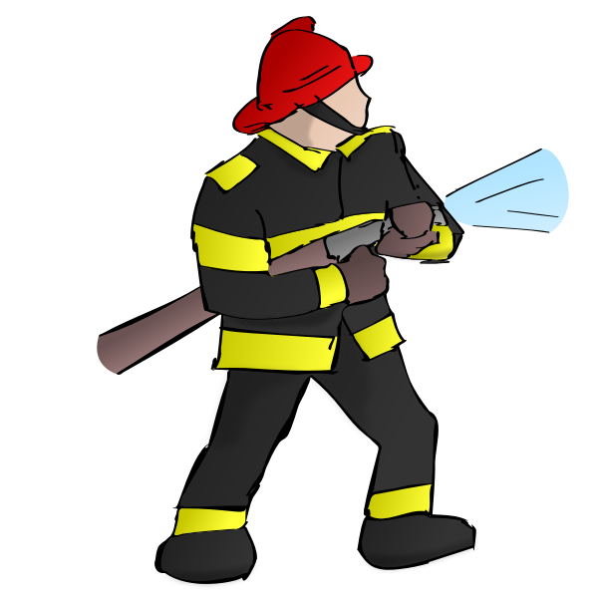

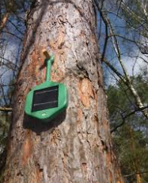
Safe Campfire Practices
Build fires in designated areas, keep them small, and never leave them unattended. Extinguish them fully before leaving
Controlled Burns and Firebreaks:
Firefighters use controlled burns and create firebreaks to remove vegetation and stop the spread of wildfires
MORE ON PREVENTION
Community Awareness and Education: Promote wildfire safety through education on evacuation plans, fire risk factors, and fire safety measures.
Monitoring and Early Detection:
Use technology and sensors to detect potential fires early and take swift action.

Slide 6
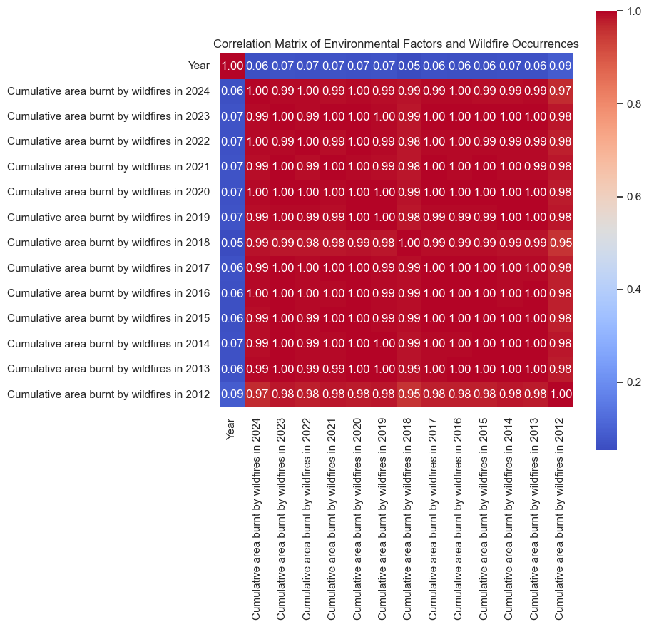
The heatmap shows the relationship between different environmental factors and wildfire occurrences. It uses colors and numbers to indicate how strongly each factor (like temperature, humidity, and vegetation) is related to the likelihood of wildfires.
Red colors mean a strong positive relationship (e.g., higher temperature = more wildfires).
Blue colors mean a strong negative relationship (e.g., more humidity = fewer wildfires).
Numbers tell you the exact strength of the relationship (from -1 to 1).
In short, the heatmap helps us see which factors are most important in predicting wildfires.

Slide 7
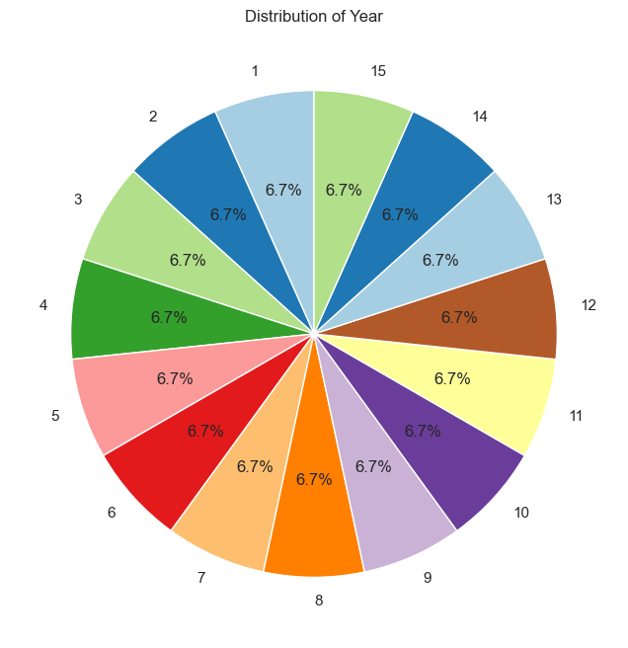
This pie chart shows the distribution of occurrences across different years in the dataset.
It displays how many times each year appears, or how frequent data points are associated with each year.
Each slice of the pie represents a specific year, and the size of each slice corresponds to the proportion of occurrences for that year in the dataset.
The percentage labels on the chart show the relative frequency of each year compared to the total number of data points, helping to quickly understand which years have more or fewer occurrences.
In summary, the chart helps to visualize the spread of data over time, highlighting which years are more prevalent in the dataset.

Slide 8
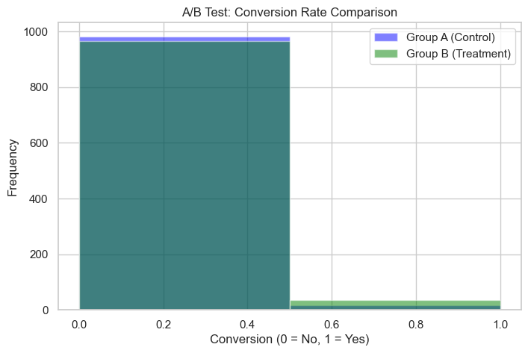
Think of the A/B test as testing two wildfire prevention methods:
Group A (Control): Areas without the new wildfire prevention method.
Group B (Treatment): Areas with the new wildfire prevention method.
The histogram shows:
Whether wildfires happened (1 = wildfire, 0 = no wildfire).
The height of the bars shows how often wildfires occurred in each group.
By comparing the blue bars (Group A) and green bars (Group B), you can see if the new prevention method (Group B) helped reduce the number of wildfires compared to the old method (Group A). If Group B has fewer wildfires, it means the new method is more effective.

Slide 9
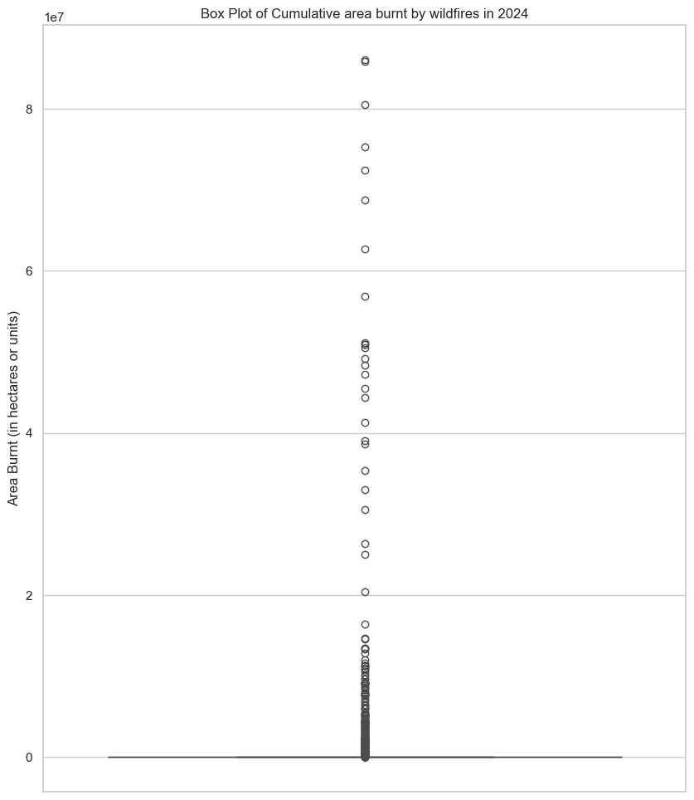
This box plot shows the distribution of the area burnt by wildfires in 2024.
The middle line of the box shows the median area burnt, which is the typical size of wildfires.
The box shows where most of the wildfire sizes fall (between the 25th and 75th percentiles).
The whiskers show the range of wildfire sizes, while dots outside the whiskers are outliers, representing unusually large wildfires.
In simple terms, this plot helps us understand the usual size of wildfires and highlights any extremely large wildfires that happened in 2024.

Slide 10
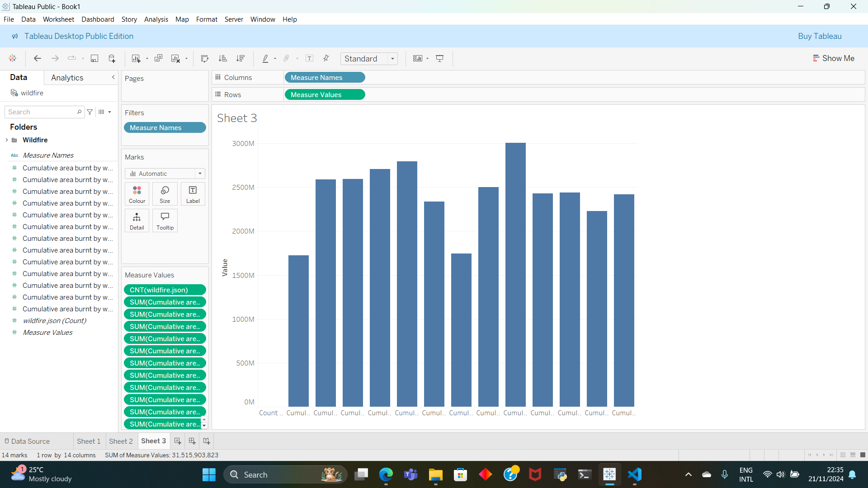

Slide 11
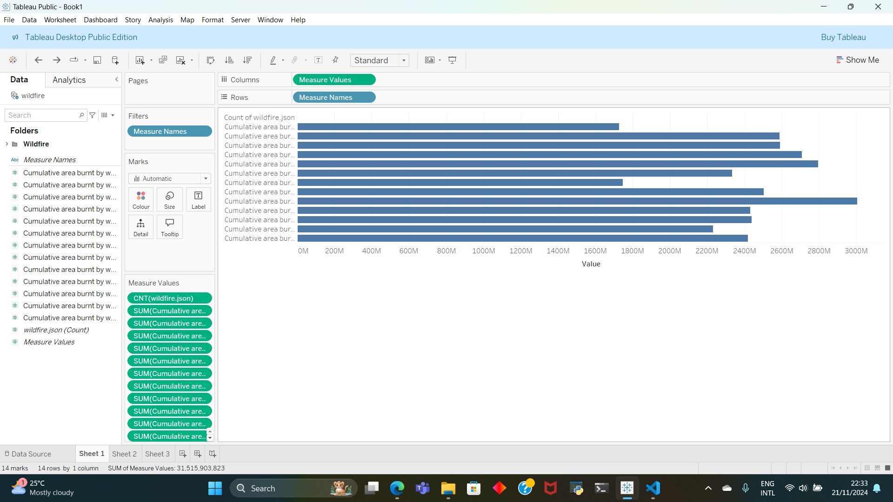

Slide 12
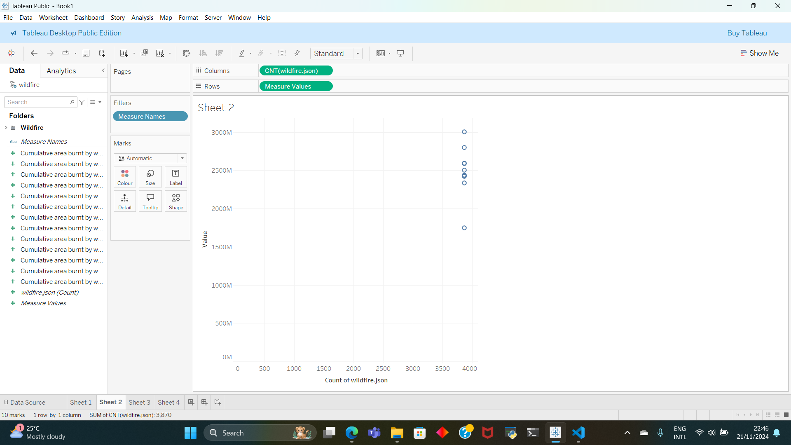

Slide 13
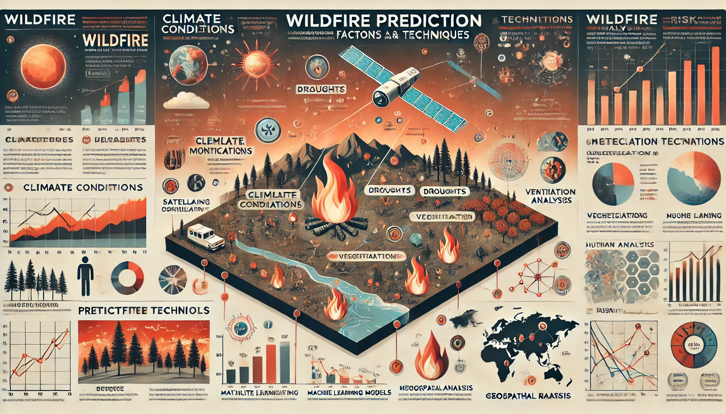
Prediction Techniques
Satellite Imagery: NASA's MODIS and VIIRS instruments monitor vegetation and active fires.
Machine Learning Models: AI algorithms analyze historical data, weather patterns, and human activity to predict wildfire likelihood.
Geospatial Analysis: Geographic Information Systems (GIS) identify high-risk zones based on vegetation and climate data.

Slide 14
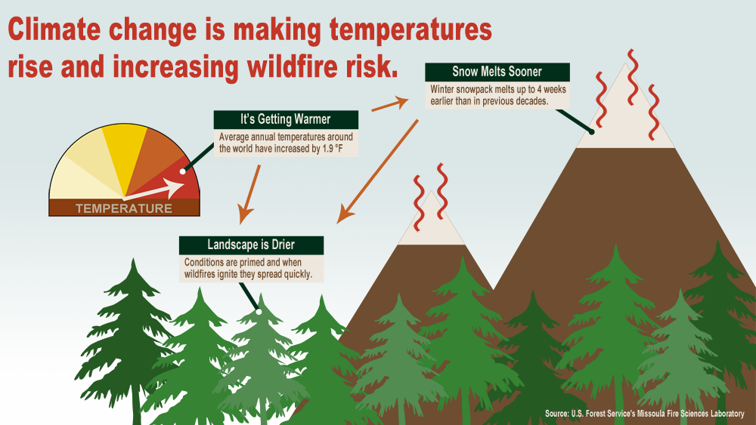

Slide 15
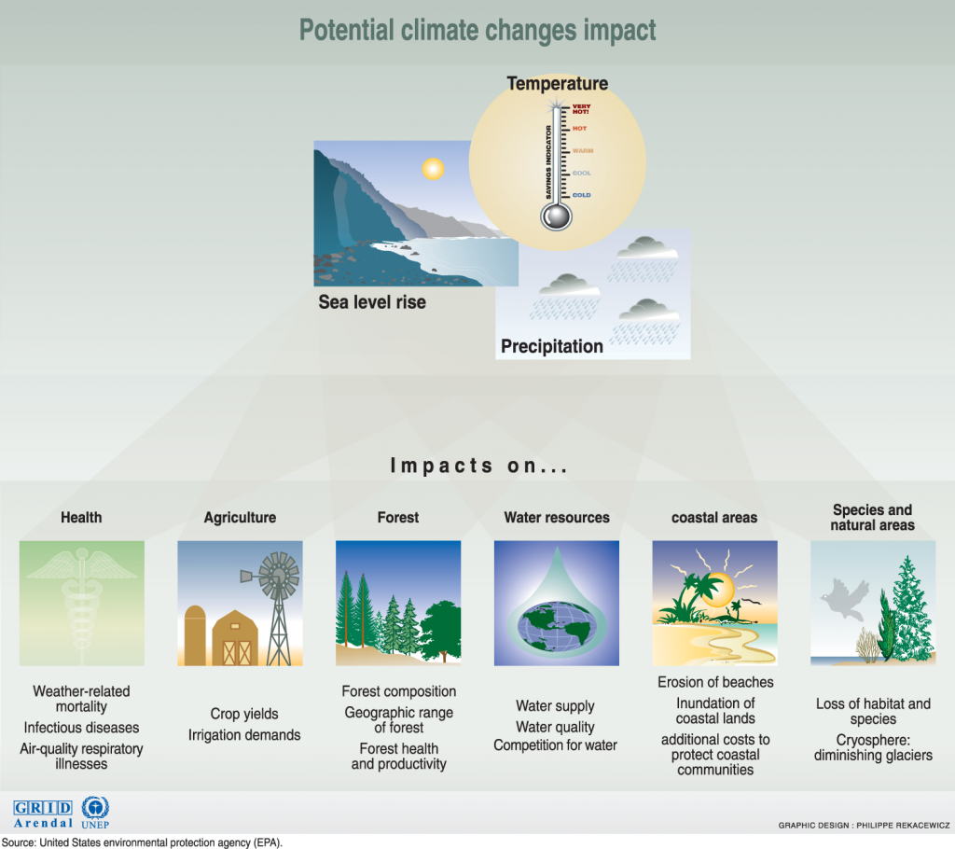
Potential Climate Changes Impact

Slide 16
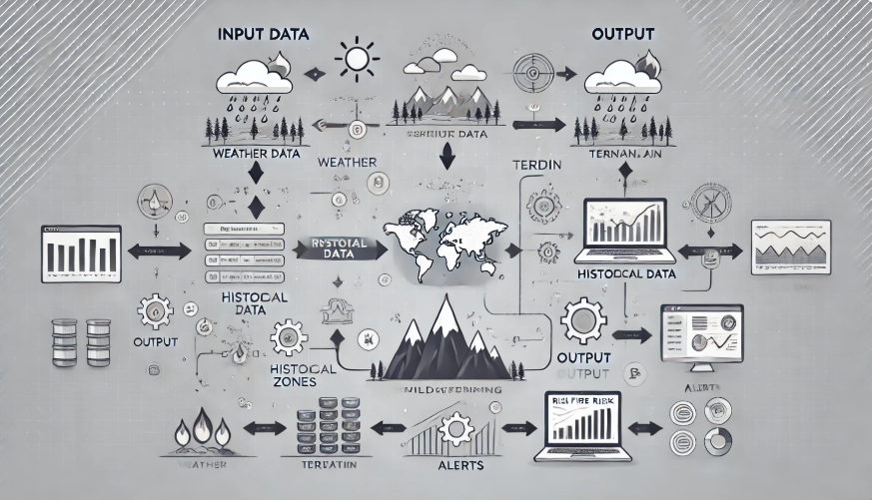
Input Data This section depicts the diverse sources of data used to predict wildfire risks.
Weather Data: Includes conditions such as temperature, humidity, wind speed, and precipitation (represented by cloud, sun, and rain icons).
Terrain Information: Considers features like elevation, slope, and topography (shown with a mountain icon).
Vegetation: Analyzes vegetation types and density, which impact fire spread (symbolized by a tree icon).
Historical Data: Utilizes records of previous wildfires to inform risk predictions (calendar icon).
2) Processing The core of the system where data is analyzed.
Machine Learning Models: This step involves training and using predictive algorithms to assess risk levels. The neural network or gear icons represent this advanced computation process.
Data Analysis: Ensures meaningful insights are drawn from complex datasets, refining risk predictions.
3) Output —--> This is the actionable stage where the processed data is visualized and used.
Real-Time Dashboard:
Displays high-risk zones on a map, enabling location-specific monitoring.
Includes charts, graphs, and alerts to communicate critical information quickly.
Notes:
SHOW HOW THE DATA ANALYSIS HELP PREDICT WILDFIRE RISK

Slide 17
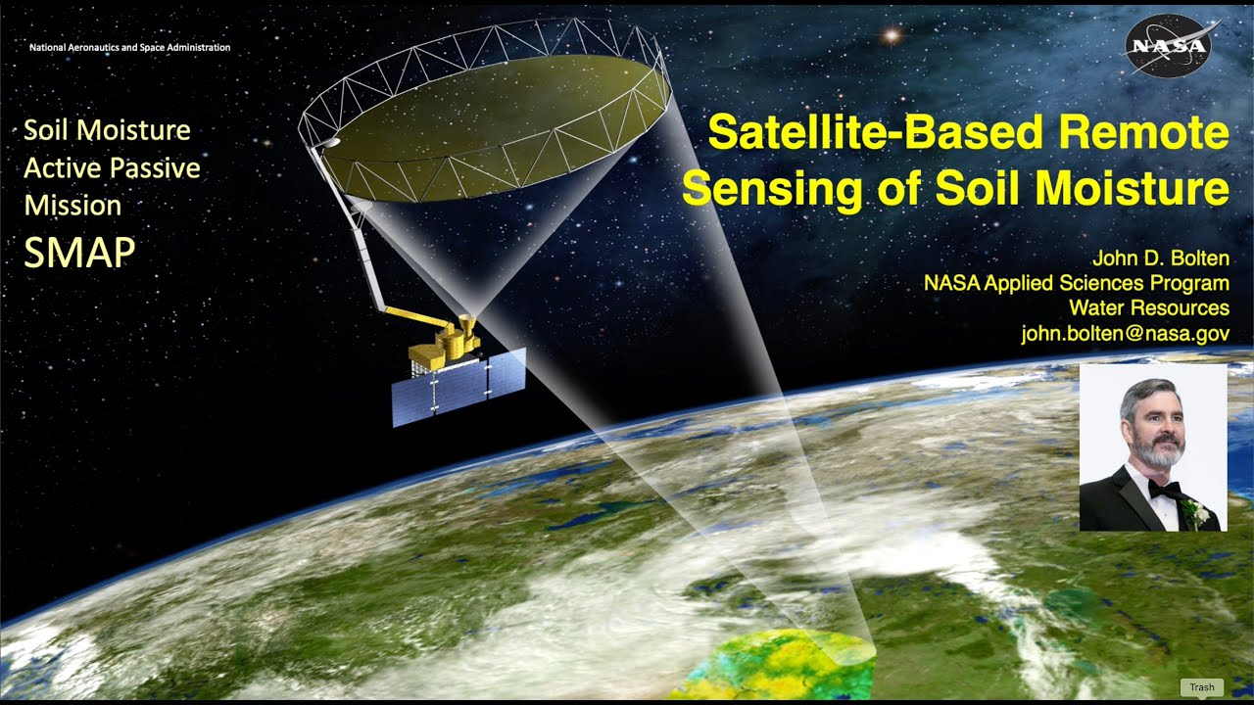
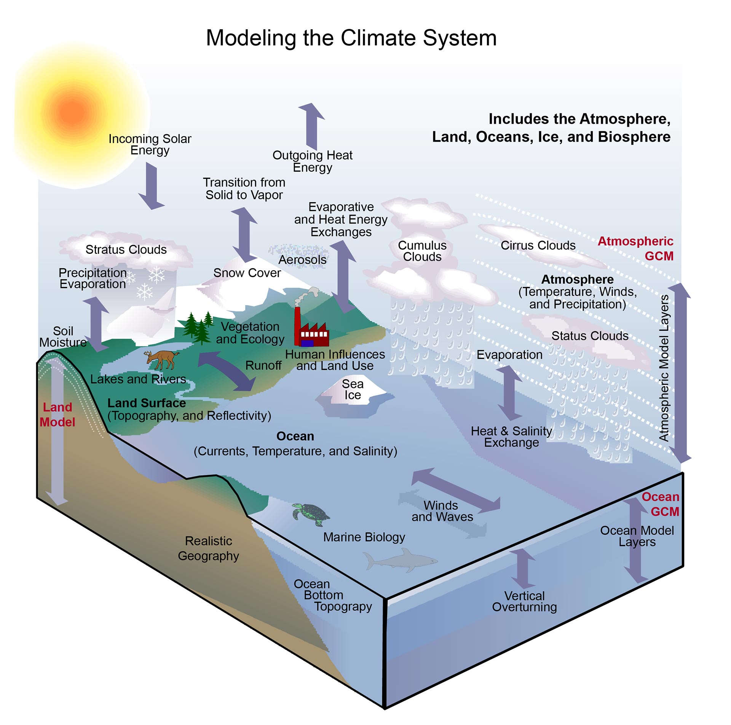
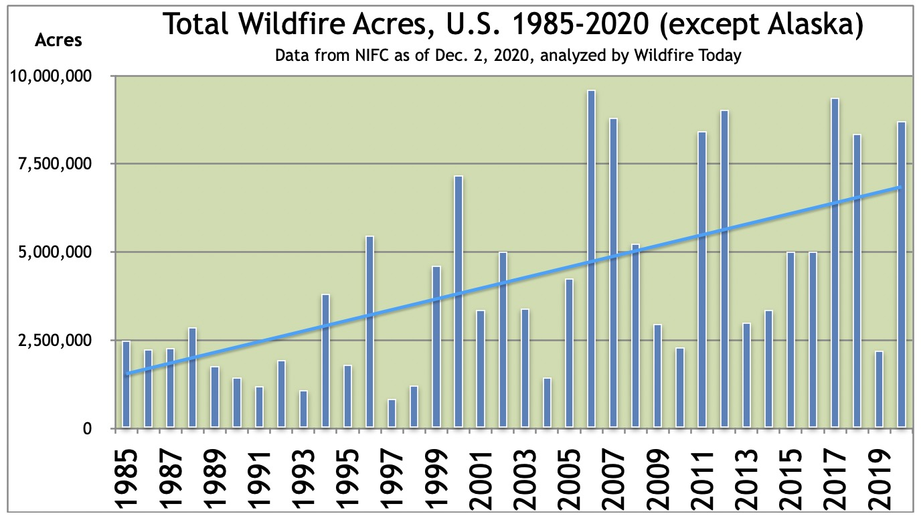
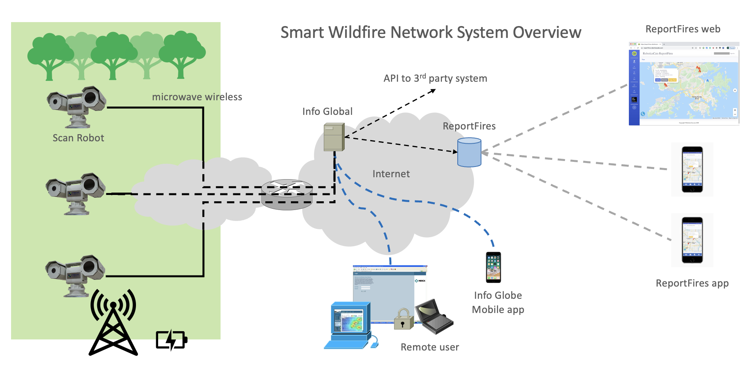
Technologies Powering Wildfire Risk Systems
Technologies Powering Wildfire Risk Systems
Remote Sensing: Satellite imagery and drones for monitoring vegetation and active fires
Climate Models: Predict droughts and heatwaves contributing to wildfire risk.
Big Data Analytics: Process vast datasets to identify trends and improve prediction accuracy.
IoT Sensors: Collect localized environmental data to detect early signs of ignition.

Slide 18
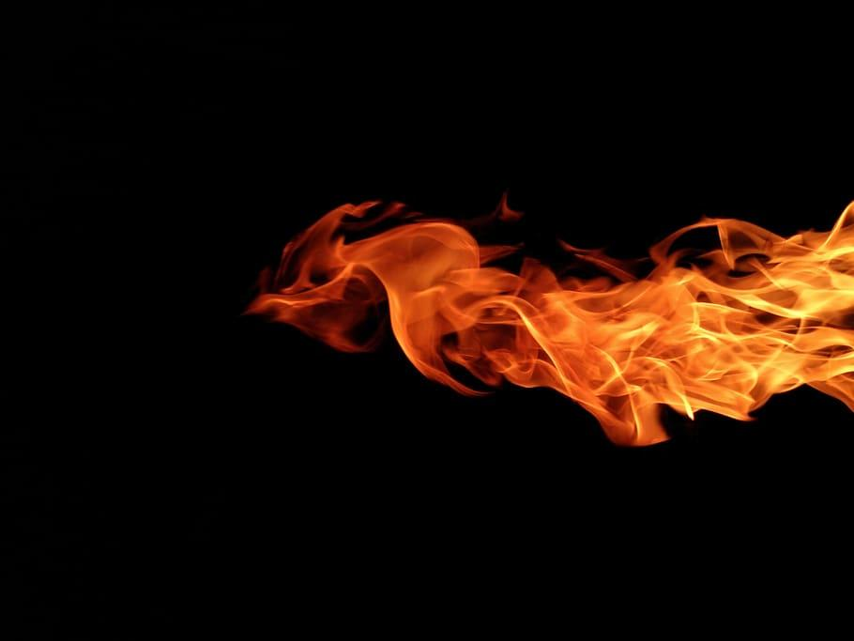
CONCLUSION
A wildfire risk and prediction system helps detect and predict wildfires early, reducing their impact on people, nature, and property. By using technologies like satellites, weather data, and artificial intelligence, these systems identify high-risk areas and provide warnings in advance.
Early Detection: Spotting wildfires quickly to reduce damage.
Accurate Predictions: Identifying areas at risk based on weather, vegetation, and past fires.
Better Response: Helping firefighters and communities prepare and act faster.
In summary, these systems are vital for saving lives, protecting ecosystems, and managing wildfires more effectively.

